Slide 1

Kickstarter Oracle
Kickstarting your kickstarter campaign

Slide 2
Content
Meet the team.
Understand the market.
Meet Kickstarter-Oracle
Commercial viability.
Technological overview.

Slide 3
The Team

Slide 4
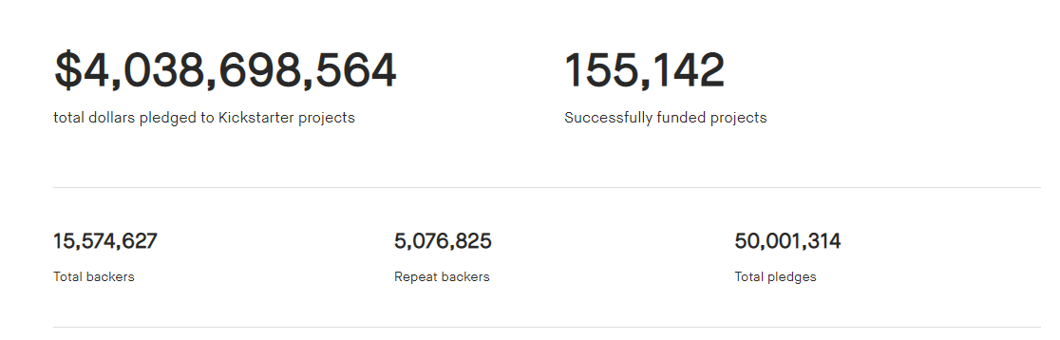
Understand the market
Current funding success rate ~36%

Slide 5
Kickstarter oracle Mission statement
Kickstarter-oracle (KO) shall provide it’s customers with highly beneficial insights for improving their funding campaign. leveraging AI technology and past campaign information KO shall play a fundamental role in it’s customers funding success..
Our success criteria : KO customers funding success rate >72%.

Slide 6
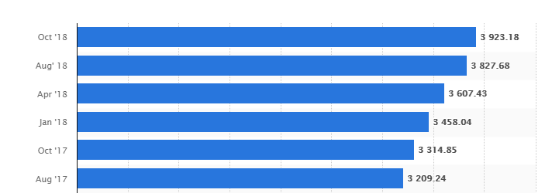
Kickstarter oracle – commercial viability
KO shall charge it’s customers a 0.1% commission of money pledged (for successful campaign).
Based on a 10% initial adoption rate KO expected monthly income ~$400K (based on Oct 2018 funding statistics)
Funds pledged for kickstarted projects ($M)

Slide 7
Data handling
Initial data: 205K lines, 45 columns, 55 data files
Data preparation activities:
Phrasing of a category column.
Split date columns into single columns per day/month/ year
Turn success/fail data into numerical
Drop missing creator lines

Slide 8
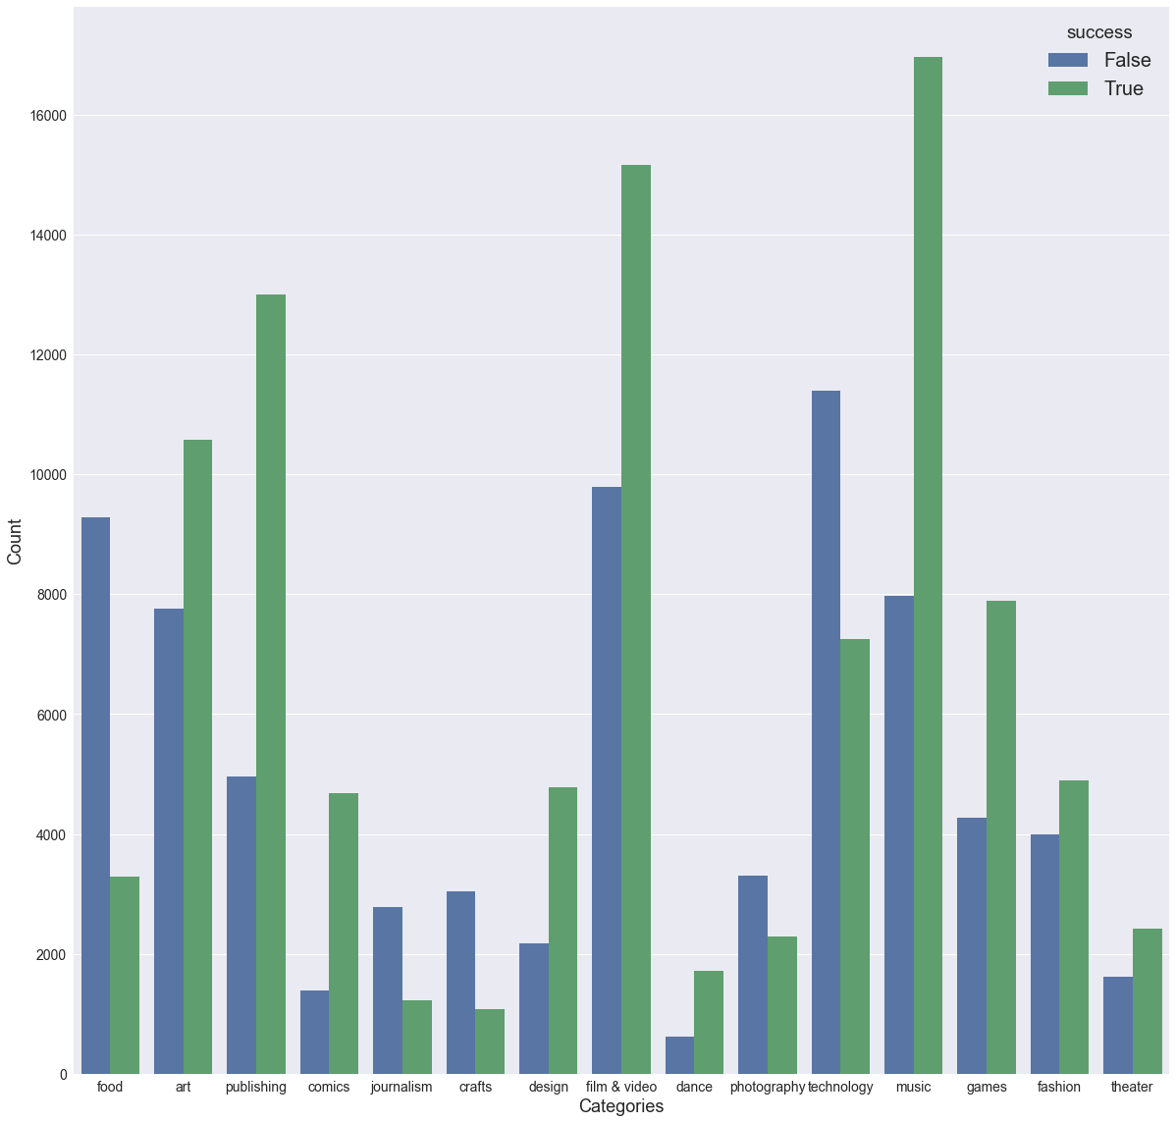
Initial observations
Clear bias towards publishing, “film and video” and music projects.
High correlation factors between success and:
Category 0.32
Staff pick 0.26

Slide 9
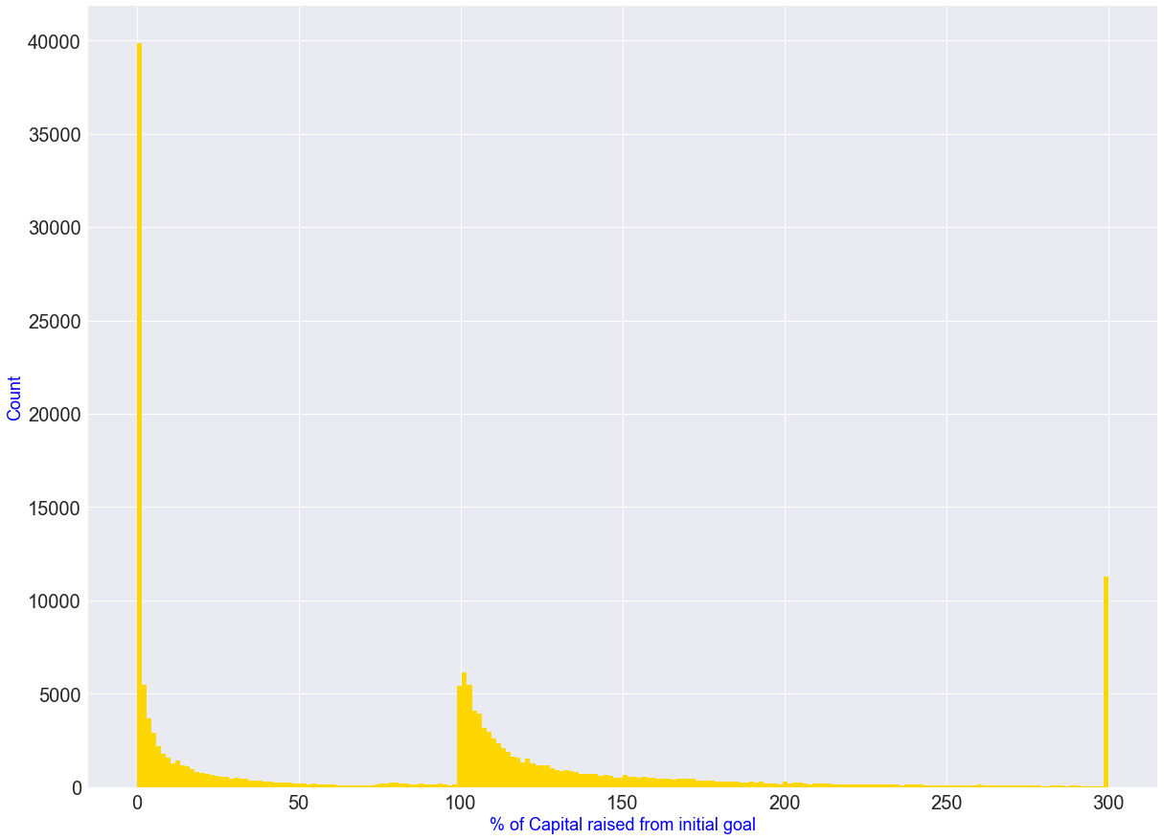
Initial observations- Continued
Most failures are attributed to lack of interest and not a funding failure
Successes distribute exponentially from target (i.e. target could have been set higher?)
Need to understand outliers

Slide 10
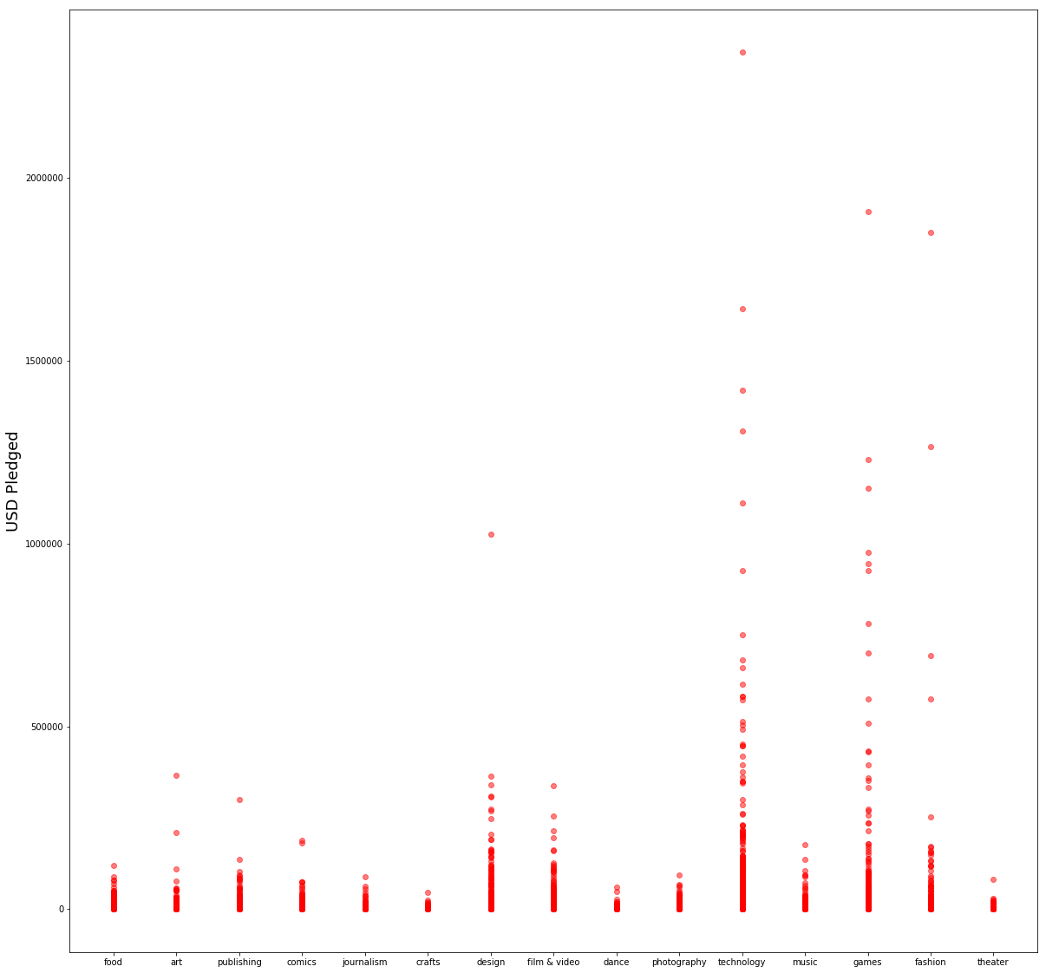
Pledged capital per area
High $ pledge projects :
Tech.
Games.
Fashion

Slide 11


Slide 12

Digital Communications
Cloud
Local
Hybrid

Slide 13

Thank You
someone@example.com

